Slide 1


CCNA EIGRP Configuration
Part 1
Presented by: Ayda Zamanian
Course Professor: Dr. Seyedreza Taghizadeh

Slide 2
To be considered charitable …
We are aimed at sharing our science in a collaborative learning environment for the advancement of the education of the public in the subject of Information Technology. So, feel free to share this video!

Slide 3
This part will cover:
1 - EIGRP Basic Configuration
2 - EIGRP Summarisation
3 - Successors and Feasible Successors

Slide 4
EIGRP (Enhanced Interior Gateway Routing Protocol)
Advanced Distance Vector routing protocol
Supports large networks
Has very fast convergence time
Supports bounded updates where network topology change updates are only sent to routers affected by the change
Messages are sent using multicast

Slide 5
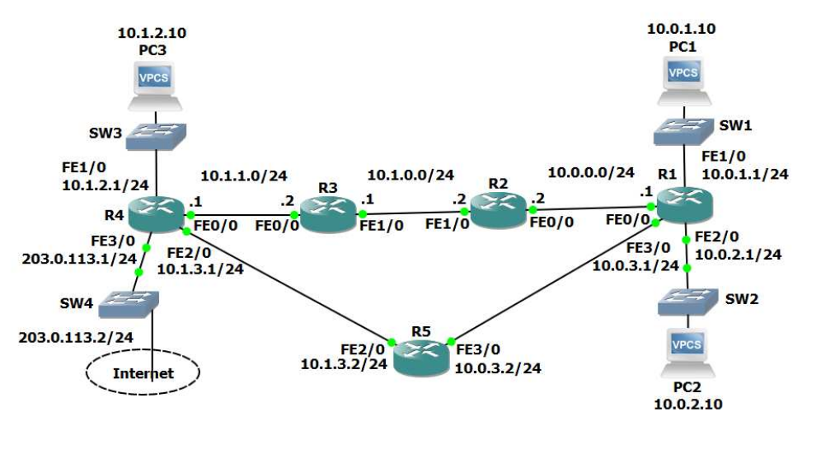
Network Topology

Slide 6
EIGRP Basic Configuration

Slide 7
1) Enable EIGRP AS 100 on every router.
Ensure all networks except 203.0.113.0/24 are advertised.
For every router:
R1#conf t
R1(config)#router eigrp 100
R1(config)#network 10.0.0.0
‘100’ is the Autonomous System (AS), meaning an independent administrative domain. EIGRP routers need to have the same AS number to peer with each
other.

Slide 8
2) Enable a loopback interface on each router.
IP address 192.168.0.x/32.
‘x’ is the router number. For example 192.168.0.3/32 on R3.
For every router:
R1(config)#interface loopback0
R1(config-if)#ip add 192.168.0.1 255.255.255.255

Slide 9
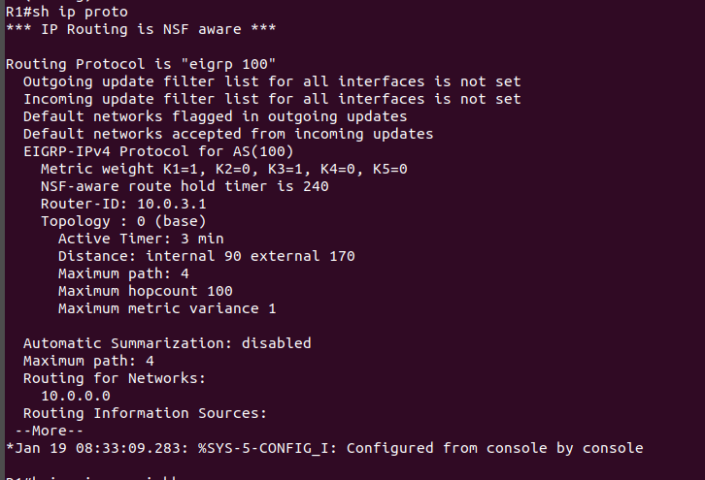
3) What do you expect the EIGRP Router ID to be on R1? Verify this.
10.0.3.1 because This was the highest IP address on the router when EIGRP was enabled.
The Router ID will change to the Loopback address 192.168.0.1 when the EIGRP process restarts.
R1#sh ip proto

Slide 10
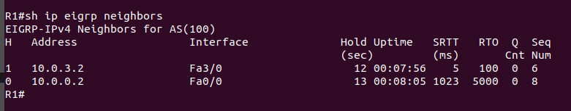
4) Verify the routers have formed adjacencies with each other.
R1#sh ip eigrp neighbors

Slide 11
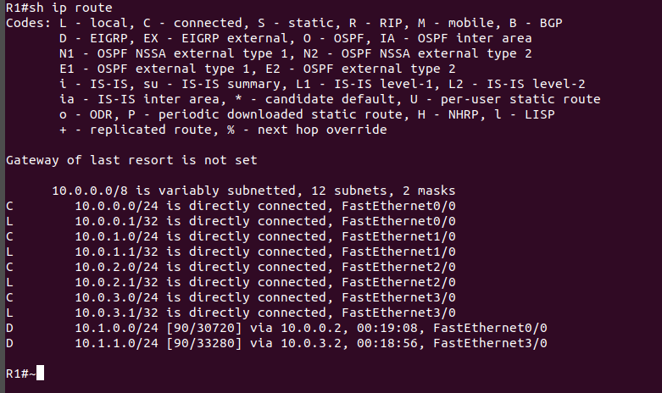
5) Verify all 10.x.x.x networks are in the router’s routing tables.
R1#sh ip route

Slide 12
EIGRP Summarisation

Slide 13
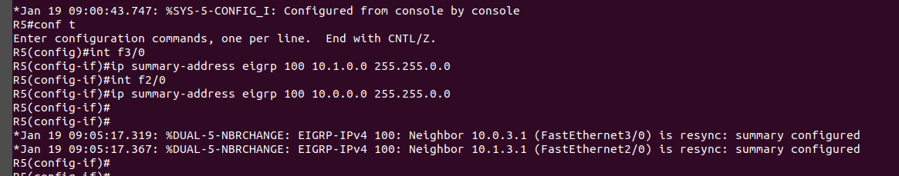
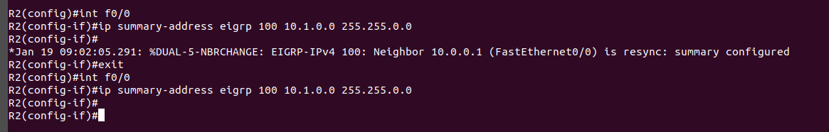
6) Enable summarisation using a /16 mask on the routers which are at the boundary of the 10.0.0.0/16 and 10.1.0.0/16 networks.
Configure summarisation in both directions on the R2 and R5 routers.

Slide 14
Network Topology

Slide 15
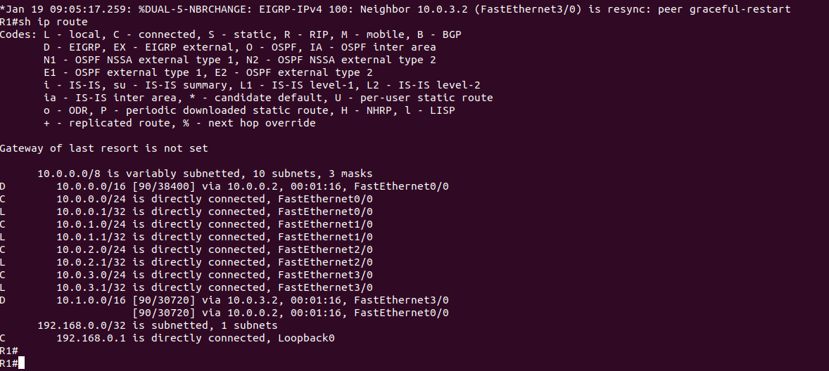
7) What change do you expect to see on R1’s routing table?
Verify this (give the routing table a few seconds to converge).
R1 will have a single /16 summary route to the 10.1.0.0 networks rather than individual /24
Routes. The routes will use Equal Cost Multi Path through routers R2 and R5.

Slide 16
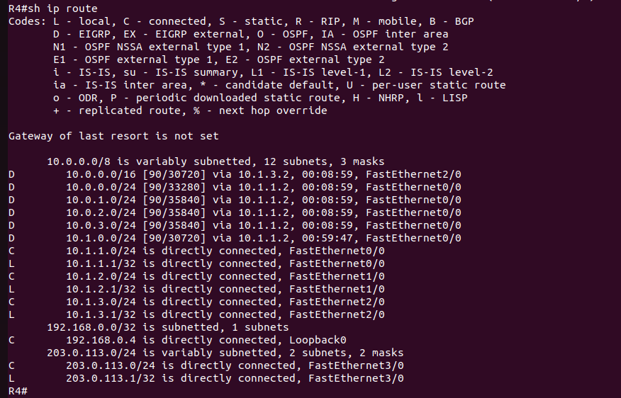
8) Will R4’s routes to the 10.0.x.x networks mirror R1’s routes to the 10.1.x.x networks? Verify this.
No. R4 will have a 10.0.0.0/16 summary route with a single next hop of 10.1.3.2 on R5. It will not load balance traffic through R2 as well because that path would have a higher metric.
(R4 is not directly adjacent to R2 as R1 is, it is an extra hop away.)

Slide 17
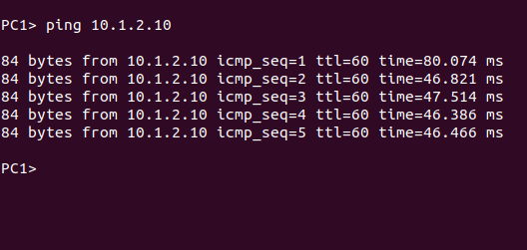
9) Verify that routing is working by checking that PC1 has connectivity to PC3.
PC1> ping 10.1.2.10

Slide 18
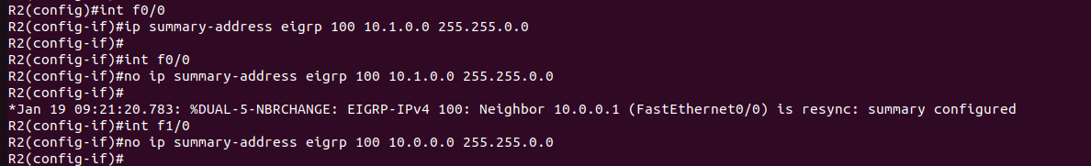
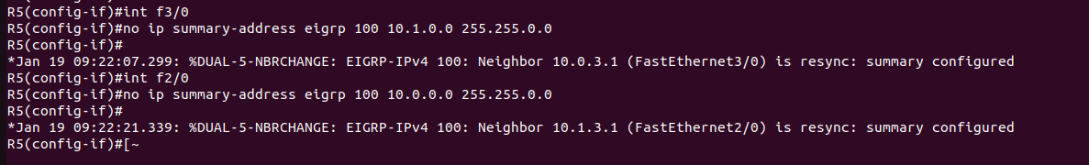
10) Remove the summary routes on the routers which are at the boundary of the 10.0.0.0/16 and 10.1.0.0/16 networks.

Slide 19
Successors and Feasible Successors

Slide 20
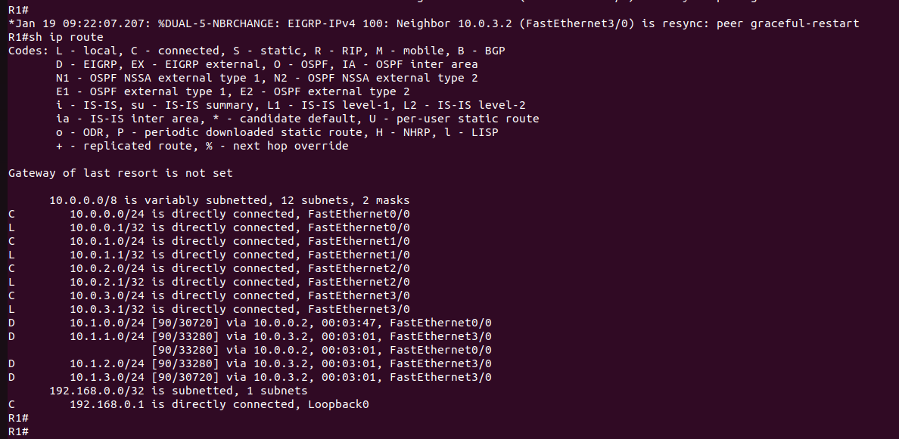
11) There are two possible paths which R1 could use to reach the 10.1.2.0/24 network – either through R2 or R5. Which route is in the routing table?
The path via R5 at 10.0.3.2.

Slide 21
List of the commands
R1#conf t
R1(config)#router eigrp 100
R1(config)#network 10.0.0.0
R1(config)#interface loopback0
R1(config-if)#ip add 192.168.0.1 255.255.255.255
R1#sh ip proto
R1#sh ip eigrp neighbors
R1#sh ip route
R2(config)#int f0/0
R2(config-if)#ip summary-address eigrp 100 10.1.0.0 255.255.0.0

Slide 22
List of the commands
PC1> ping 10.1.2.10
R2(config-if)#int f0/0
R2(config-if)#no ip summary-address eigrp 100 10.1.0.0 255.255.0.0

Slide 23
THANK YOU!

